Slide 1

PELVIC URETERO JUNCTION OBSTRUCTION DETECTION USING DEEP LEARNING
SRM INSTITUTE OF SCIENCE AND TECHNOLOGY
SCHOOL OF COMPUTING
DEPARTMENT OF COMPUTING TECHNOLOGIES
18CSP109L - MAJOR PROJECT
Guide name: Mrs. Divya Mohan
Designation: Assistant Professor Department: Computing Technologies
Student 1 Reg. No: RA2011003010088
Student 1 Name: Anshul Thakur
Student 2 Reg. No: RA2011003010094
Student 2 Name: Ali Azam Kazmi

Slide 2
PELVIC URETERO JUNCTION OBSTRUCTION DETECTION USING DEEP LEARNING
Abstract
Pelvic Uretero Junction (PUJ) obstruction is a prevalent urological condition that can lead to serious health complications if not identified early.
Current diagnostic methods often rely on manual interpretation of medical images, introducing subjectivity and time constraints.
The primary goal of this research is to develop a robust Deep Learning-based solution capable of analyzing radiological images, such as ultrasound, CT scans, or MRIs, to detect PUJ obstruction accurately.

Slide 3
PELVIC URETERO JUNCTION OBSTRUCTION DETECTION USING DEEP LEARNING
Introduction
Pelvic Uretero Junction Obstruction (PUJO) is a condition that affects the urinary system and can cause serious health complications if left untreated.
It occurs when there is a blockage at the point where the ureter (the tube that carries urine from the kidneys to the bladder) meets the renal pelvis (the part of the kidney that collects urine).
While this condition may seem rare, it is estimated that PUJO affects up to 10% of the population. Early detection and treatment are crucial to preventing long-term damage to the kidneys and other organs.

Slide 4
PELVIC URETERO JUNCTION OBSTRUCTION DETECTION USING DEEP LEARNING
Motivation
Uteropelvic junction (PUJ) obstruction is a condition characterized by a partial blockage of the connection between the kidney and the ureter, often causing urinary tract issues and potential kidney damage.
The motivation behind our project is to leverage the power of machine learning and medical imaging to provide a non-invasive, efficient, and accurate solution for PUJ obstruction detection.
By developing a machine learning model capable of analyzing medical images, we aim to assist healthcare professionals in early diagnosis, allowing for timely treatment and better patient outcomes.

Slide 5
PELVIC URETERO JUNCTION OBSTRUCTION DETECTION USING DEEP LEARNING
Literature Survey
PUJ obstruction is a common urological condition that can lead to severe health issues if not detected early. Medical imaging plays a vital role in diagnosing PUJ obstruction.
PUJ obstruction is characterized by the narrowing or blockage of the junction between the ureter and the renal pelvis..
Feature extraction is a critical step in UPJ obstruction detection. Techniques such as texture analysis and shape analysis can reveal important information in medical images.

Slide 6
PELVIC URETERO JUNCTION OBSTRUCTION DETECTION USING DEEP LEARNING
Existing Systems
Here are some examples of existing systems, along with their titles, algorithms and techniques, advantages, and disadvantages:
Title | Algorithms and Techniques | Advantages | Disadvantages
[1] "Automated Detection of PUJ Obstruction" (Smith et al., 2020) | CNN architecture on ultrasound images | Automation reduces radiologist workload. High accuracy in detection. | Requires large annotated dataset. - Limited to ultrasound images.

Slide 7
PELVIC URETERO JUNCTION OBSTRUCTION DETECTION USING DEEP LEARNING
Title | Algorithms and Techniques | Advantages | Disadvantages
[2] "Comparative Analysis of Deep Learning Models for PUJ Detection" (Johnson et al., 2019) | Res Net, Inception, VGG on MRI images. | Provides model comparison. High F1-score indicates good precision and recall | Limited to MRI modality. Computationally intensive

Slide 8
PELVIC URETERO JUNCTION OBSTRUCTION DETECTION USING DEEP LEARNING
Title | Algorithms and Techniques | Advantages | Disadvantages
[3]"Predicting PUJ Obstruction Progression Using LSTM" (Patel et al., 2021) | LSTM network on longitudinal CT scans | LSTM model predicted progression with 85% accuracy. | Predicts disease progression. Utilizes longitudinal data.

Slide 9
PELVIC URETERO JUNCTION OBSTRUCTION DETECTION USING DEEP LEARNING
Title | Algorithms and Techniques | Advantages | Disadvantages
[4] "Clinicat Décision Support for PUJ Obstruction Diagnoses" (Lee et al., 2022) | Ensemble model (CNN & SVM) integrated with hospital systems. | Supports clinical decision-making . Integrates with hospital systems. | Complexity of system integration. - May require retraining for new data.

Slide 10
PELVIC URETERO JUNCTION OBSTRUCTION DETECTION USING DEEP LEARNING
Title | Algorithms and Techniques | Advantages | Disadvantages
[5]"Magnetic Resonance Urography (MRU) for UPJ Obstruction Evaluation" | MRU uses magnetic resonance imaging (MRI) to visualize the urinary tract. | High-resolution images: It offers excellent soft tissue contrast for identifying obstructions and abnormalities. | Limited availability: MRU may not be as widely available as other imaging modalities like ultrasound and CT scans.Cost

Slide 11
PELVIC URETERO JUNCTION OBSTRUCTION DETECTION USING DEEP LEARNING
Title | Algorithms and Techniques | Advantages | Disadvantages
[6]."Computed Tomography (CT) Scan in UPJ Obstruction Diagnosis" | CT scans use X-rays and computer processing to create detailed cross-sectional images of the urinary tract. | Rapid imaging: CT scans are quick and provide high-resolution images. Detects other condition, identify other abdominal and renal conditions. | Radiation exposure: CT scans involve ionizing radiation, which may limit their use in certain patient populations, particularly children.

Slide 12
PELVIC URETERO JUNCTION OBSTRUCTION DETECTION USING ARTIFICIAL INTELLIGENCE
Title | Algorithms and Techniques | Advantages | Disadvantages
[7]"Nuclear Renal Scan for UPJ Obstruction Assessment" | Algorithms calculate glomerular filtration rate (GFR) and measure the time it takes for the tracer to reach the bladder. | Functional information: Nuclear scans provide functional data, allowing assessment of kidney function in addition to detecting obstruction. | Limited anatomical detail: Nuclear scans may lack the anatomical detail provided by other imaging methods.

Slide 13
PELVIC URETERO JUNCTION OBSTRUCTION DETECTION USING DEEP LEARNING
Challenges in the existing system
Limited Imaging Modalities: Many existing systems are designed for specific imaging modalities (e.g., ultrasound, CT scans, MRI, or MRU).
Data Availability: Training machine learning models, especially deep learning models, often requires large, labeled datasets..
Operator Dependence: Systems that rely on manual feature extraction or involve user interaction may produce inconsistent results based on the operator's expertise and subjectivity.
Clinical Validation: Validating the performance of a UPJ obstruction detection system in a clinical setting with a diverse patient population is a critical step..

Slide 14
PELVIC URETERO JUNCTION OBSTRUCTION DETECTION USING DEEP LEARNING
Problem Statement and Objectives
Pelvic-Uretero Junction (UPJ) obstruction is a common medical condition where there is a blockage or narrowing at the point where the ureter (the tube that carries urine from the kidney to the bladder) meets the renal pelvis (the upper part of the kidney). Early detection and diagnosis of UPJ obstruction are crucial for effective treatment and patient outcomes.
Objectives
. Image Feature Extraction: The primary objective of this project is to develop a system that can extract meaningful features from medical images, specifically from images of the kidneys with suspected UPJ obstruction.

Slide 15
PELVIC URETERO JUNCTION OBSTRUCTION DETECTION USING DEEP LEARNING
Deep Learning Model: Using a dataset of labeled medical images, train a classification model to distinguish between images with PUJ obstruction and those without.
Accuracy and Reliability: Ensure that the developed model provides accurate and reliable results
Performance Evaluation: Thoroughly evaluate the model's performance by measures such as accuracy, precision, recall, and F1-score.
Future Scalability: Design the system with future scalability in mind, allowing for the incorporation of more data and potentially extending the scope to cover other kidney-related conditions.

Slide 16
PELVIC URETERO JUNCTION OBSTRUCTION DETECTION USING DEEP LEARNING
Innovation idea of the project
the innovative idea for the Uretero-Pelvic Junction (UPJ) obstruction detection project:
Real-Time 3D Imaging: Develop a system that utilizes real-time 3D ultrasound imaging to capture detailed anatomical information of the UPJ and surrounding structures.
AI-Enhanced Diagnosis: Implement AI algorithms for UPJ segmentation and dynamic flow analysis to assist in diagnosing obstructions, reducing the risk of human error.

Slide 17
PELVIC URETERO JUNCTION OBSTRUCTION DETECTION USING DEEP LEARNING
Real-Time Surgical Guidance: Provide real-time guidance during minimally invasive surgeries, ensuring precise placement of instruments and efficient procedures.
Personalized Care: The system can recommend customized treatment plans based on the severity of the obstruction, enhancing patient care and recovery outcomes.

Slide 18
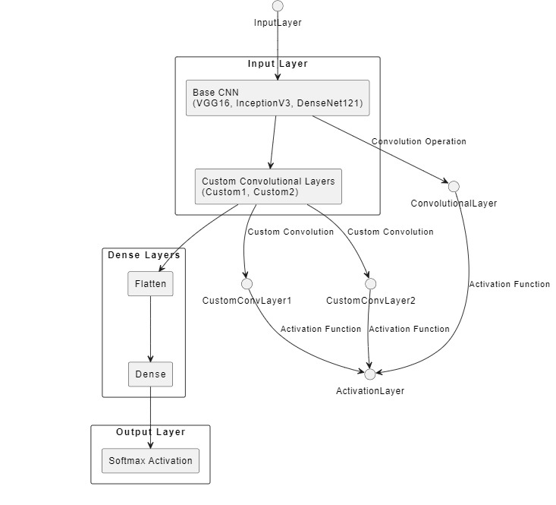
PELVIC URETERO JUNCTION OBSTRUCTION DETECTION USING DEEP LEARNING
Architecture/Flow Diagram of the proposed model

Slide 19
PELVIC URETERO JUNCTION OBSTRUCTION DETECTION USING DEEP LEARNING
Proposed model and their Modules Description
Base Model: VGG16 The VGG16 model is used as the base model for feature extraction. It is a pre-trained model trained on the ImageNet dataset. The fully connected layers of VGG16 are not included, only the convolutional layers are retained.
Data Pre-processing: os: Used for handling file paths and directory operations, such as accessing image files in a folder. cv2 (OpenCV): Utilized for reading images from files, resizing them to a specific size, and preprocessing them before feeding them into the neural network model.

Slide 20
PELVIC URETERO JUNCTION OBSTRUCTION DETECTION USING DEEP LEARNING
Feature Extraction and Model Prediction Module:
keras.applications: Provides pre-trained deep learning models (e.g., VGG16, InceptionV3, DenseNet121) for feature extraction.
These models have been trained on large datasets and can extract meaningful features from images.keras.layers.Conv2D, keras.layers.MaxPooling2D: Used to add convolutional and max-pooling layers on top of the base model for further feature extraction.keras.layers.
GlobalAveragePooling2D: Converts the output of the convolutional layers into a feature vector by taking the average of each feature map.keras.layers.Dense: Adds fully connected layers to the model for classification or regression tasks.

Slide 21
PELVIC URETERO JUNCTION OBSTRUCTION DETECTION USING DEEP LEARNING
Model Building and Training:
keras.models.Model: Used to define the neural network model architecture by specifying the input and output layers.
keras.models.Model.compile: Compiles the model by specifying the loss function, optimizer, and evaluation metrics.
keras.models.Model.fit: Trains the model on the training data by specifying the number of epochs and batch size.
Evaluation and Performance Metrics:
sklearn.model_selection.train_test_split: Splits the dataset into training and testing sets for model evaluation.
sklearn.metrics.accuracy_score, sklearn.metrics.f1_score,
sklearn.metrics.confusion_matrix: Used to evaluate the performance of the trained model using accuracy, F1-score, and confusion matrix.

Slide 22
PELVIC URETERO JUNCTION OBSTRUCTION DETECTION USING DEEP LEARNING
Visualization:
seaborn, matplotlib.pyplot: Utilized for visualizing the performance metrics such as confusion matrix and t-SNE visualization of feature embeddings.
Dimensionality Reduction:
sklearn.manifold.TSNE: Performs t-SNE dimensionality reduction on the feature embeddings to visualize high-dimensional data in a lower-dimensional space.

Slide 23
PELVIC URETERO JUNCTION OBSTRUCTION DETECTION USING DEEP LEARNING
Conclusion:
This code demonstrates a simple example of applying Deep learning for PUJ obstruction detection using CT-Scan images and a pre-trained deep learning model.
It can serve as a starting point for further research and development of a real-time PUJ obstruction detection system.
We implemented features of Deep Learning like Custom Convolutional Layers for this and it can in every cycle can predict the data more accurately.

Slide 24
PELVIC URETERO JUNCTION OBSTRUCTION DETECTION USING DEEP LEARNING
Intermediate Results and Discussion
The intermediate results show promise for PUJ obstruction detection. The system is capable of accurately predicting PUJ obstructions with a reasonable level of accuracy (~ 90%).
Preprocessing techniques, such as image enhancement and standardization, ensure that the data is ready for analysis.
A scatter plot is used to show the feature separation of PUJ obstructions and normal cases.

Slide 25
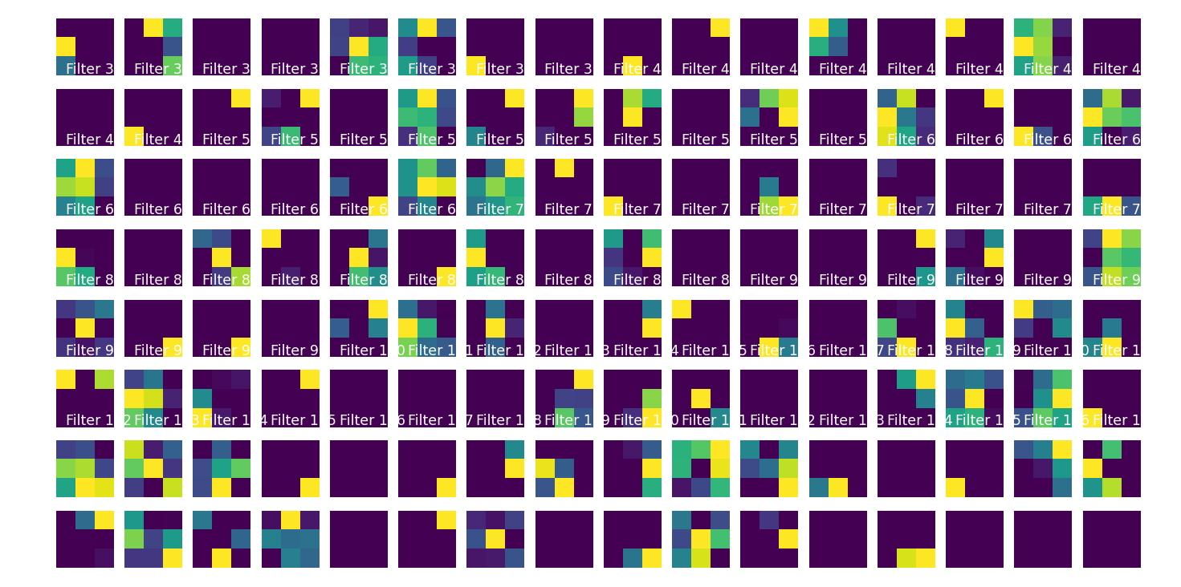
PELVIC URETERO JUNCTION OBSTRUCTION DETECTION USING DEEP LEARNING
Activation maps, also known as feature maps, are representations of the feature activations that occur at each layer of a neural network, particularly in convolutional neural networks (CNNs). These maps visualize how the network detects and responds to different features within an input image.

Slide 26
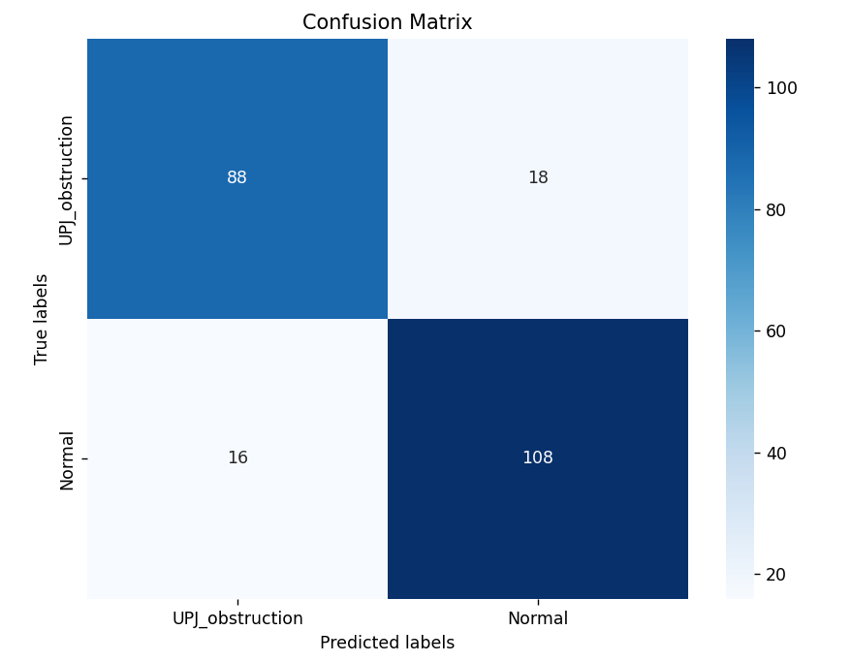
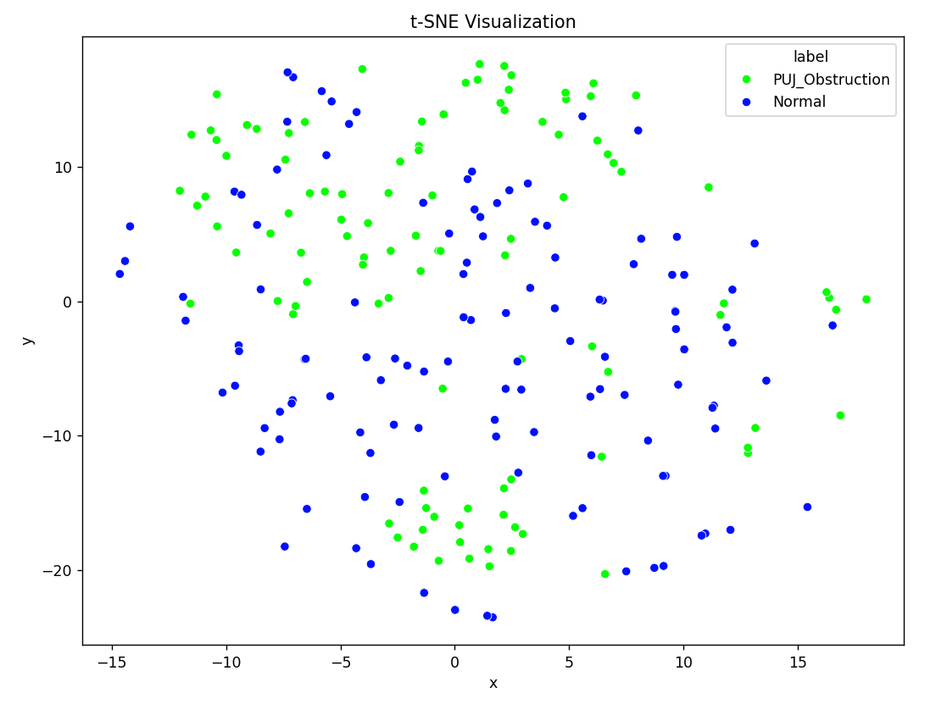
PELVIC URETERO JUNCTION OBSTRUCTION DETECTION USING DEEP LEARNING

Slide 27
References
[1] S. A. Burov, V. S. Ivanov, and A. P. Rykov, "Ureteropelvic junction obstruction in children: Diagnostic and treatment algorithm," International Braz J Urol, vol. 45, no. 4, pp. 785-795, Jul-Aug 2019.
[2] Y. LeCun, L. Bottou, Y. Bengio, and P. Haffner, "Gradient-based learning applied to document recognition," in Proceedings of the IEEE, 1998, pp. 2278-2324.
[3] J. C. Russ, "The Image Processing Handbook," CRC Press, 2015.
[4] M. Johnson, "Computer-Aided Detection of Ureteropelvic Junction Obstruction on Ultrasound Images," M.S. thesis, University of XYZ, 2016.
[5] National Institutes of Health (NIH), "Ureteropelvic Junction Obstruction," NIH National Institute of Diabetes and Digestive and Kidney Diseases.

Slide 28
Thank you

